Slide 1
Developments to established dose-finding methodologies for application in trials with complex and innovative designs
Notes:
Hi, my name is Amit and I’m a biostatistician at the cancer research clinical trials unit in the university. My Ph.D. revolves around early phase trial designs, more specifically dose finding trials and developments to these methodologies.

Slide 2
Implementing novel methodology into an early phase head and neck cancer trial
Notes:
Today I will be talking about one of the chapters in my phd which details the implementation of a novel design into a trial that is being run at the unit.

Slide 3
Early phase dose-finding trials
Aim: To obtain the Recommended Phase II dose (RP2D)
Trials are typically small (20 – 40 patients)
Three Ethical Criteria
Do not want to undertreat
Do not want to overtreat
Use as few patients as possible (efficiency)
Notes:
First, I will give a quick introduction to early phase dose-finding trials and what they are.

Slide 4
Early phase dose-finding trials
Fundamental Assumption:
Higher dose → Higher chance of toxicity (and higher chance of efficacious response)
If monotonic assumption is true,
RP2D = Maximum Tolerated Dose (MTD), highest possible dose with an “acceptable” risk of
Dose Limiting Toxicity (DLT; yes/no)
We determine what is acceptable based on a pre-defined target level of toxicity.

Slide 5
Classic 3+3 Design
Proceed to next higher dose or same dose level if already at highest dose level
Proceed to next higher dose or declare MTD otherwise
DLT = 0/3
DLT = 1/6
Give new dose level to new cohort of 3 subjects
DLT = 1/3
Enrol 3 additional subjects at the same dose
Proceed to next lower dose or declare MTD at next lower dose if 6 patients already tested there.
DLT ≥ 2/6
DLT ≥ 2/3
Proceed to next lower dose or declare MTD at next lower dose level if 6 patients already tested there.

Slide 6
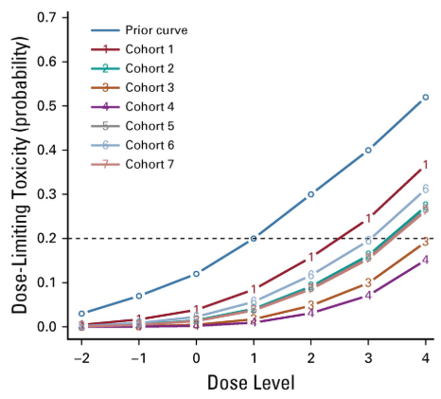
Continual Reassessment Method

Slide 7
ADePT-DDR

Slide 8
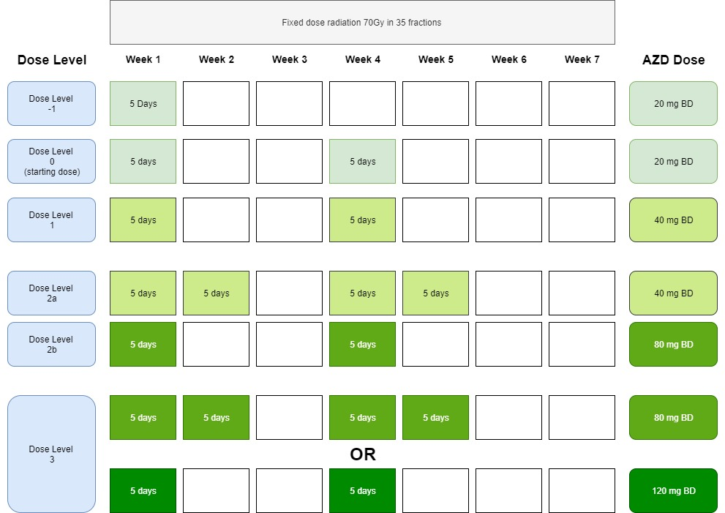
Trial Schema

Slide 9
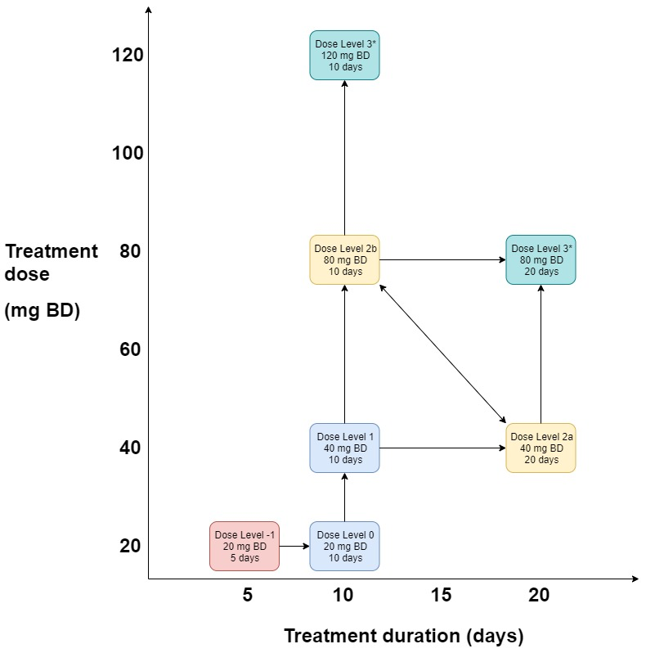
Dose Pathway

Slide 10
CRM for partial orders
Primarily used when the ordering of some of the doses is unknown
In this trial there are 2 possible orderings for the dose levels
Each order has a dose toxicity model
Prior probabilities are assigned to each model which represent the plausibility of each order
Once data is collected posterior probabilities can be established for each of the models
Select the model with the highest posterior probability and apply the standard form of the CRM
0
1
2a
2b
3
-1
0
1
2b
2a
3

Slide 11
TITE-CRM
TITE-CRM is a variant of the regular CRM which handles late-onset toxicities
TITE-CRM presents a solution by introducing the notion of a partial tolerance event.
If a patient is half way through the evaluation window and has not yet experienced toxicity, we may say that they have experienced half a tolerance.
In the absence of a toxic response each patient is weighted by the proportion of the full observation period they have been observed
This is done using a weighted dose response model where the weight is a function of the time-to-event of each patient and has a linear association with the dose toxicity model.

Slide 12
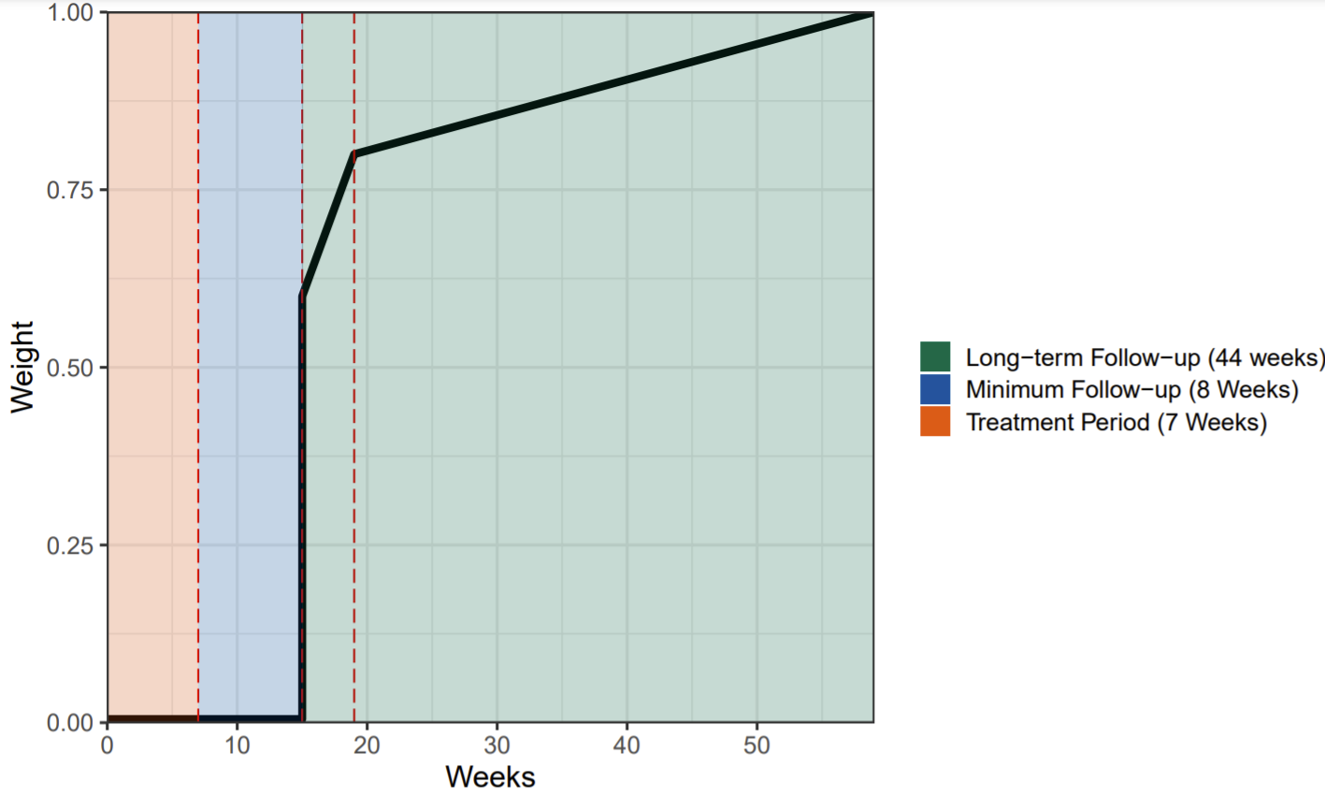

Slide 13
Application
Both orderings are equally feasible
Target dose with 25% DLT probability
Two stage design:
Stage 1 – Follow a pre defined dose escalation scheme if no DLTs are observed
Stage 2 – Once a DLT is observed the PO-TITE-CRM is used to determine the next dose
Stopping rules:
Once we reach 60 patients
Sufficient evidence that the MTD is reached
Excess toxicity at the lowest dose – P(tox>0.35)>0.80

